Slide 1
Boxycharm
(what is expected October 2017)
Subscription $21 a month
Jazz journey
Value: Liquid $41 or
Value: $58
Value: $20
Value: Pressed $38
Thefelicianojourney.com
Jazz journey

Slide 2
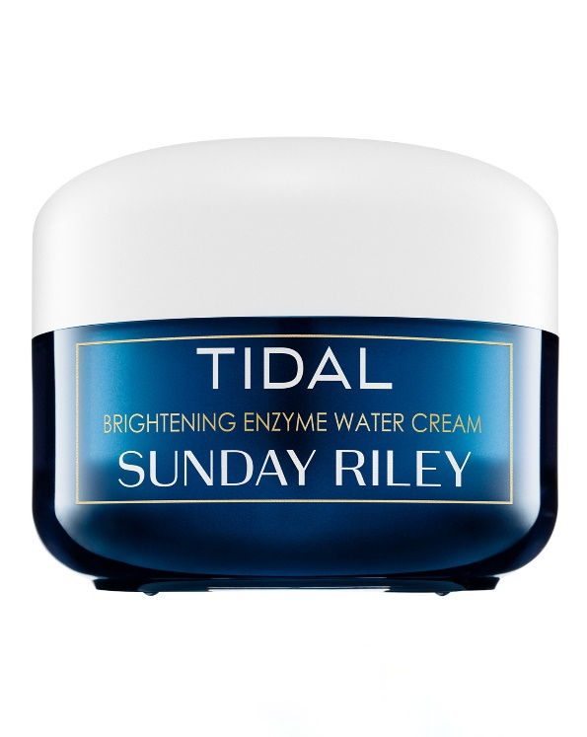
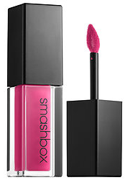
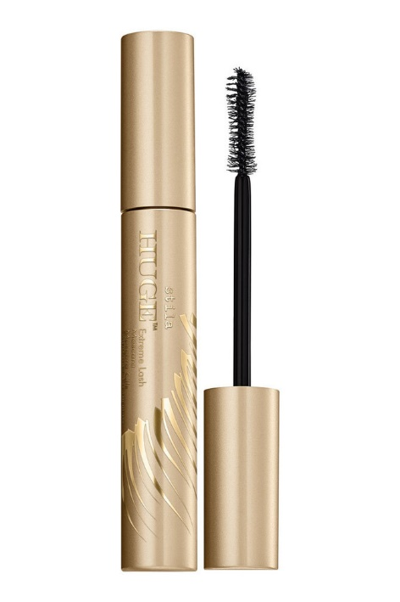
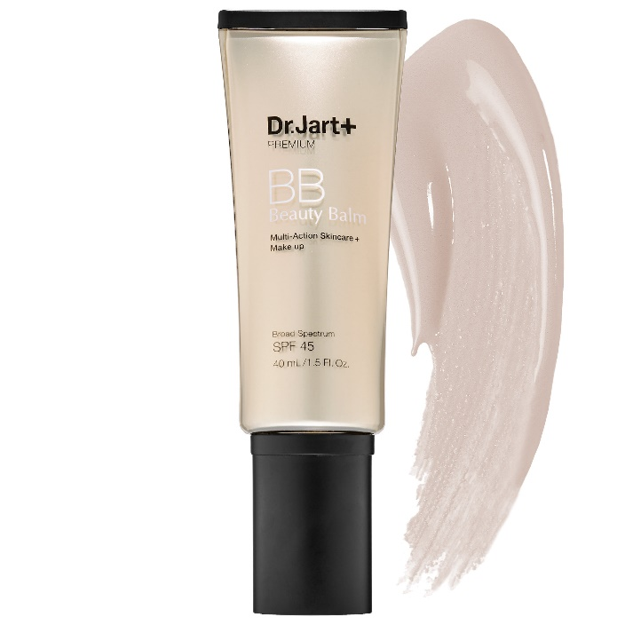
Birchbox
(what is expected november 2017)
Subscription $10 a month
Jazz journey
Thefelicianojourney.com
Jazz journey

Slide 3
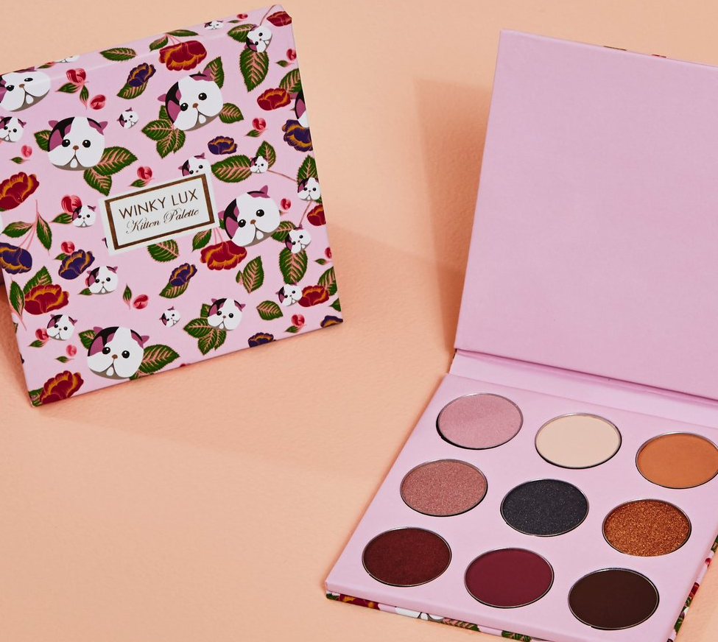
Boxycharm
(what is expected november 2017)
Subscription $21 a month
Jazz journey
Thefelicianojourney.com
Jazz journey

Slide 4
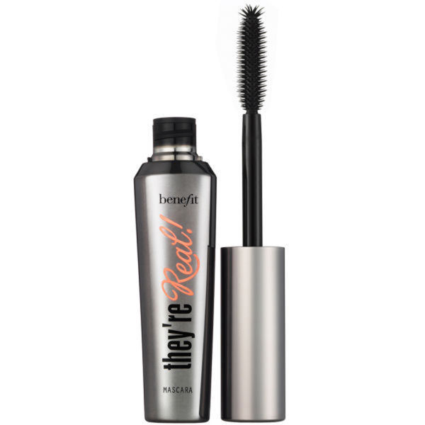
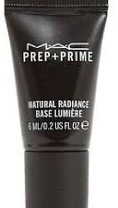
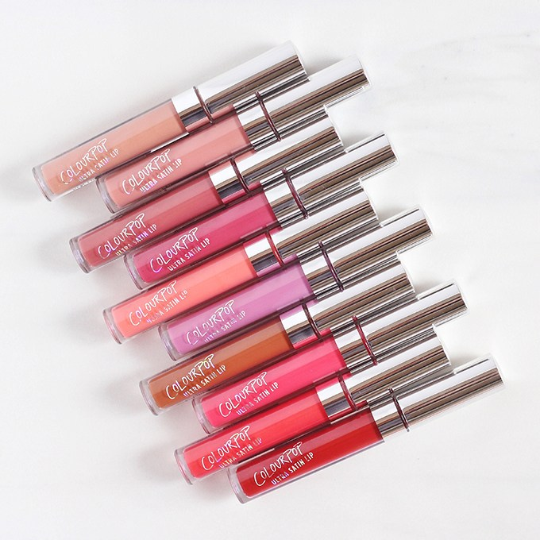
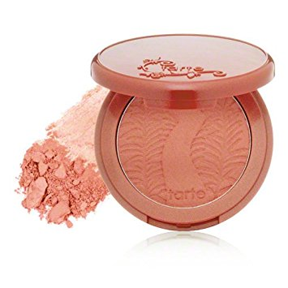
ipsy
(what is expected november 2017)
Subscription $10 a month
Jazz journey
Thefelicianojourney.com
Jazz journey

